Slide 1
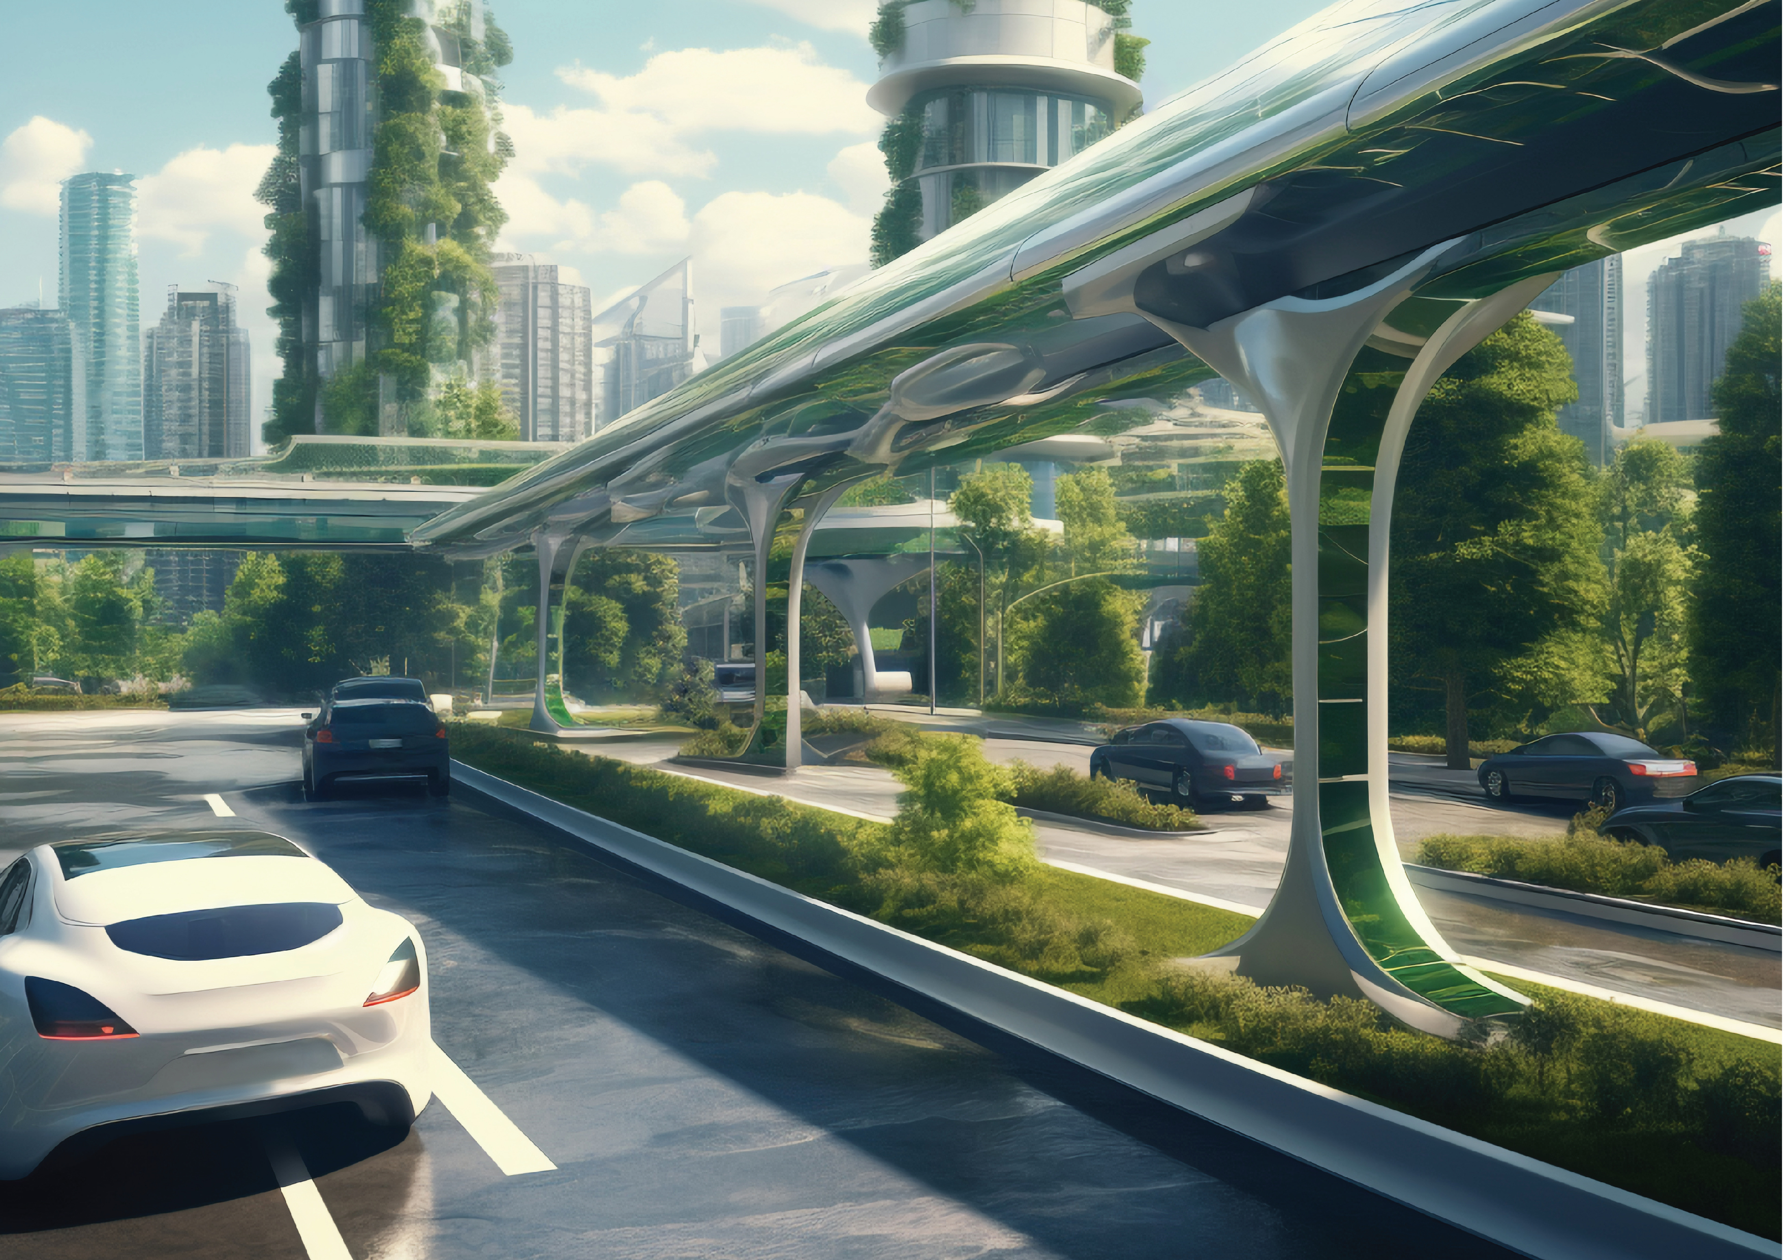




#UGDMN
Ultimate
Global
Disaster
Mitigation
Nexus
Advance Feasibility Study
&
Business Plan
Earth Climate and Geological Risks
From
Galactic Cosmic Rays (GCRs)
&
The Sun
by
:man:
: Phouthone: Siharath.
totrade.co
team@totrade.co
Latest
totrade.co/cr
Notes:
#UGDMN WORKING PAPER
#UGDMN means Ultimate Global Disaster Mitigation Nexus
It is Feasibility Study and Business Plan Earth Climate and Geological Risks
from Galactic Cosmic Rays (GCRs)
Instead of Outdated Climate Hansenism which will be explained later at first.
by Phouthone Siharath
Totrade.co
team@totrade.co

Slide 2
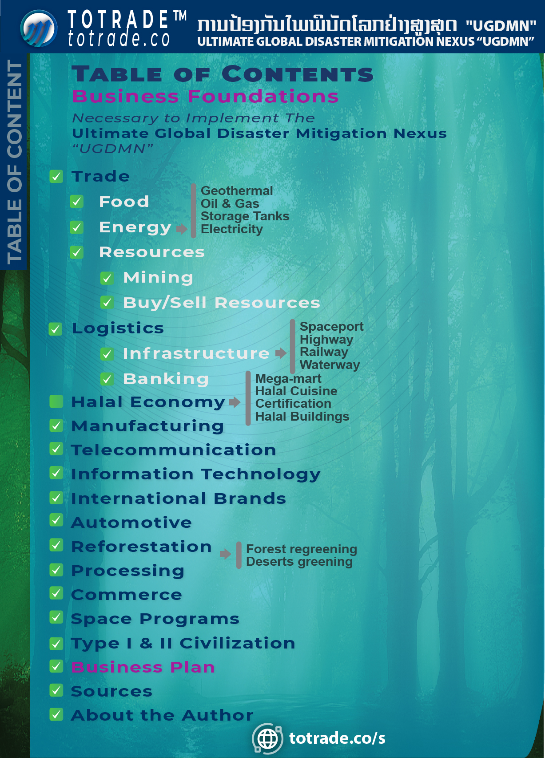
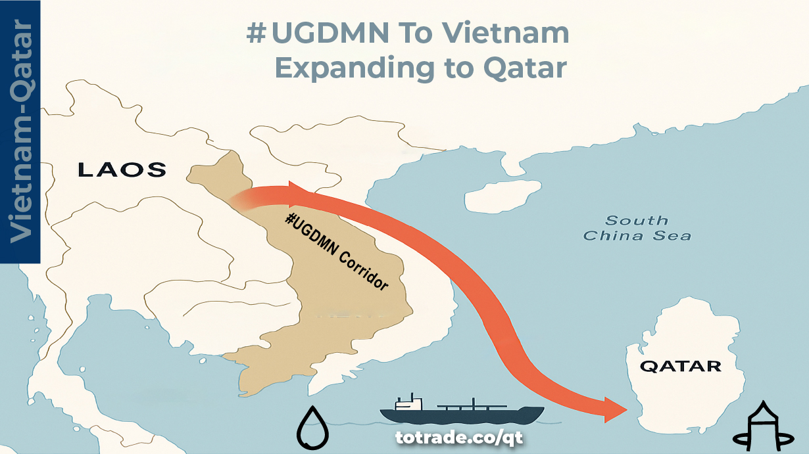
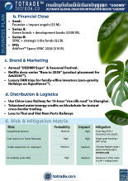
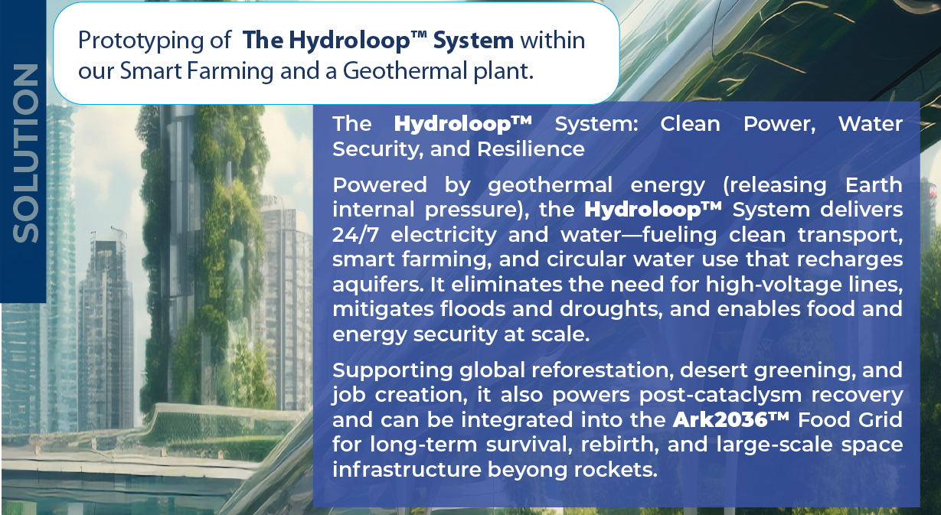
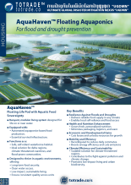
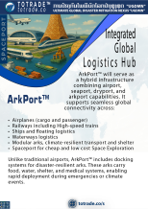
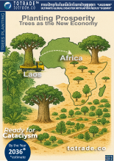
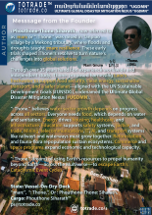

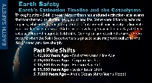
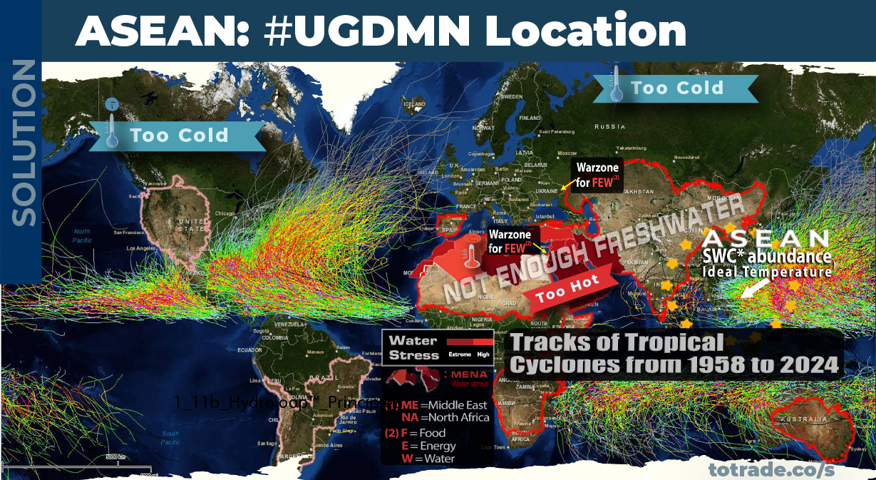
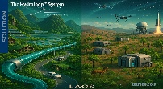
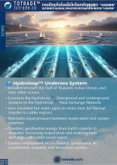
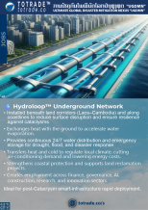
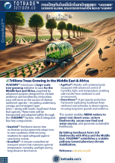
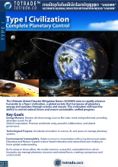
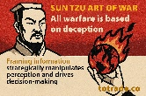
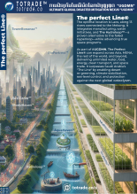

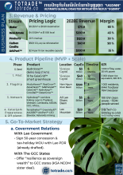
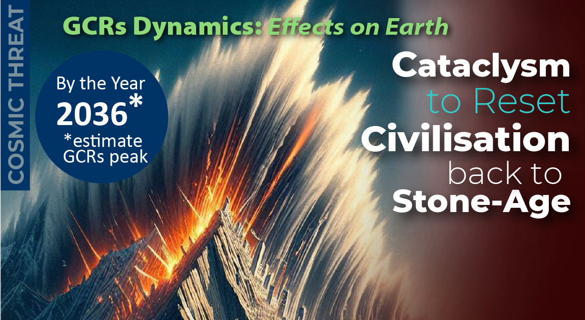

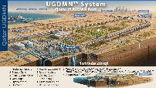
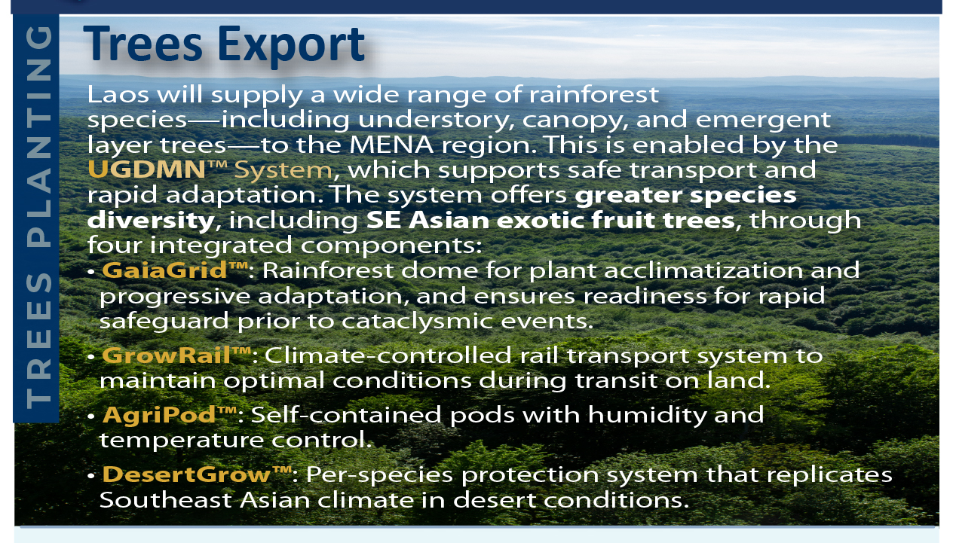
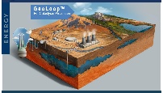


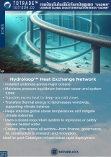

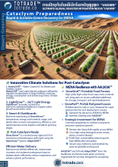
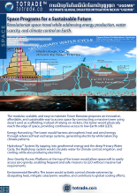
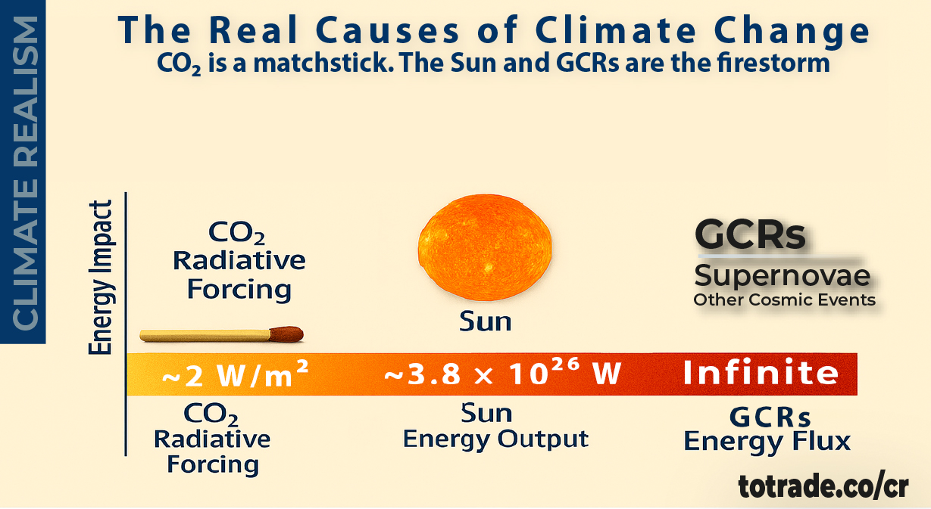
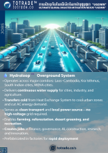
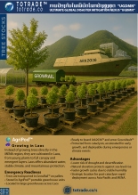

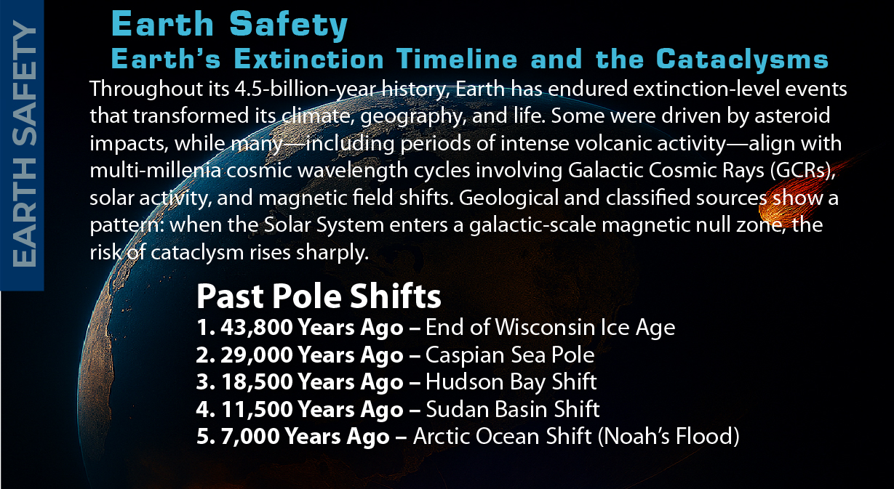
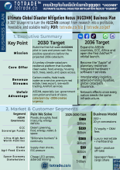
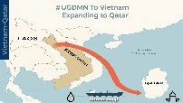
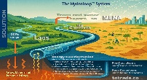
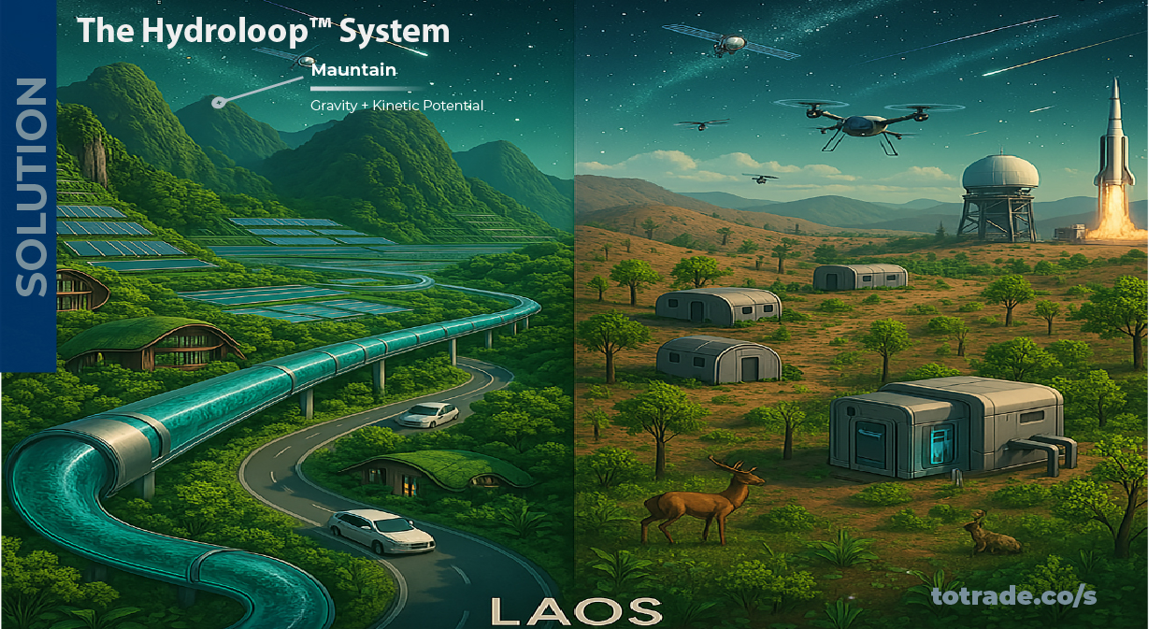
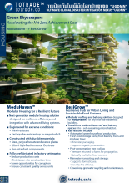
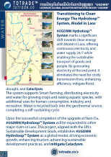


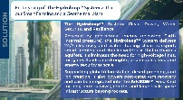



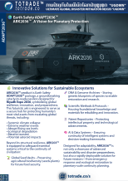

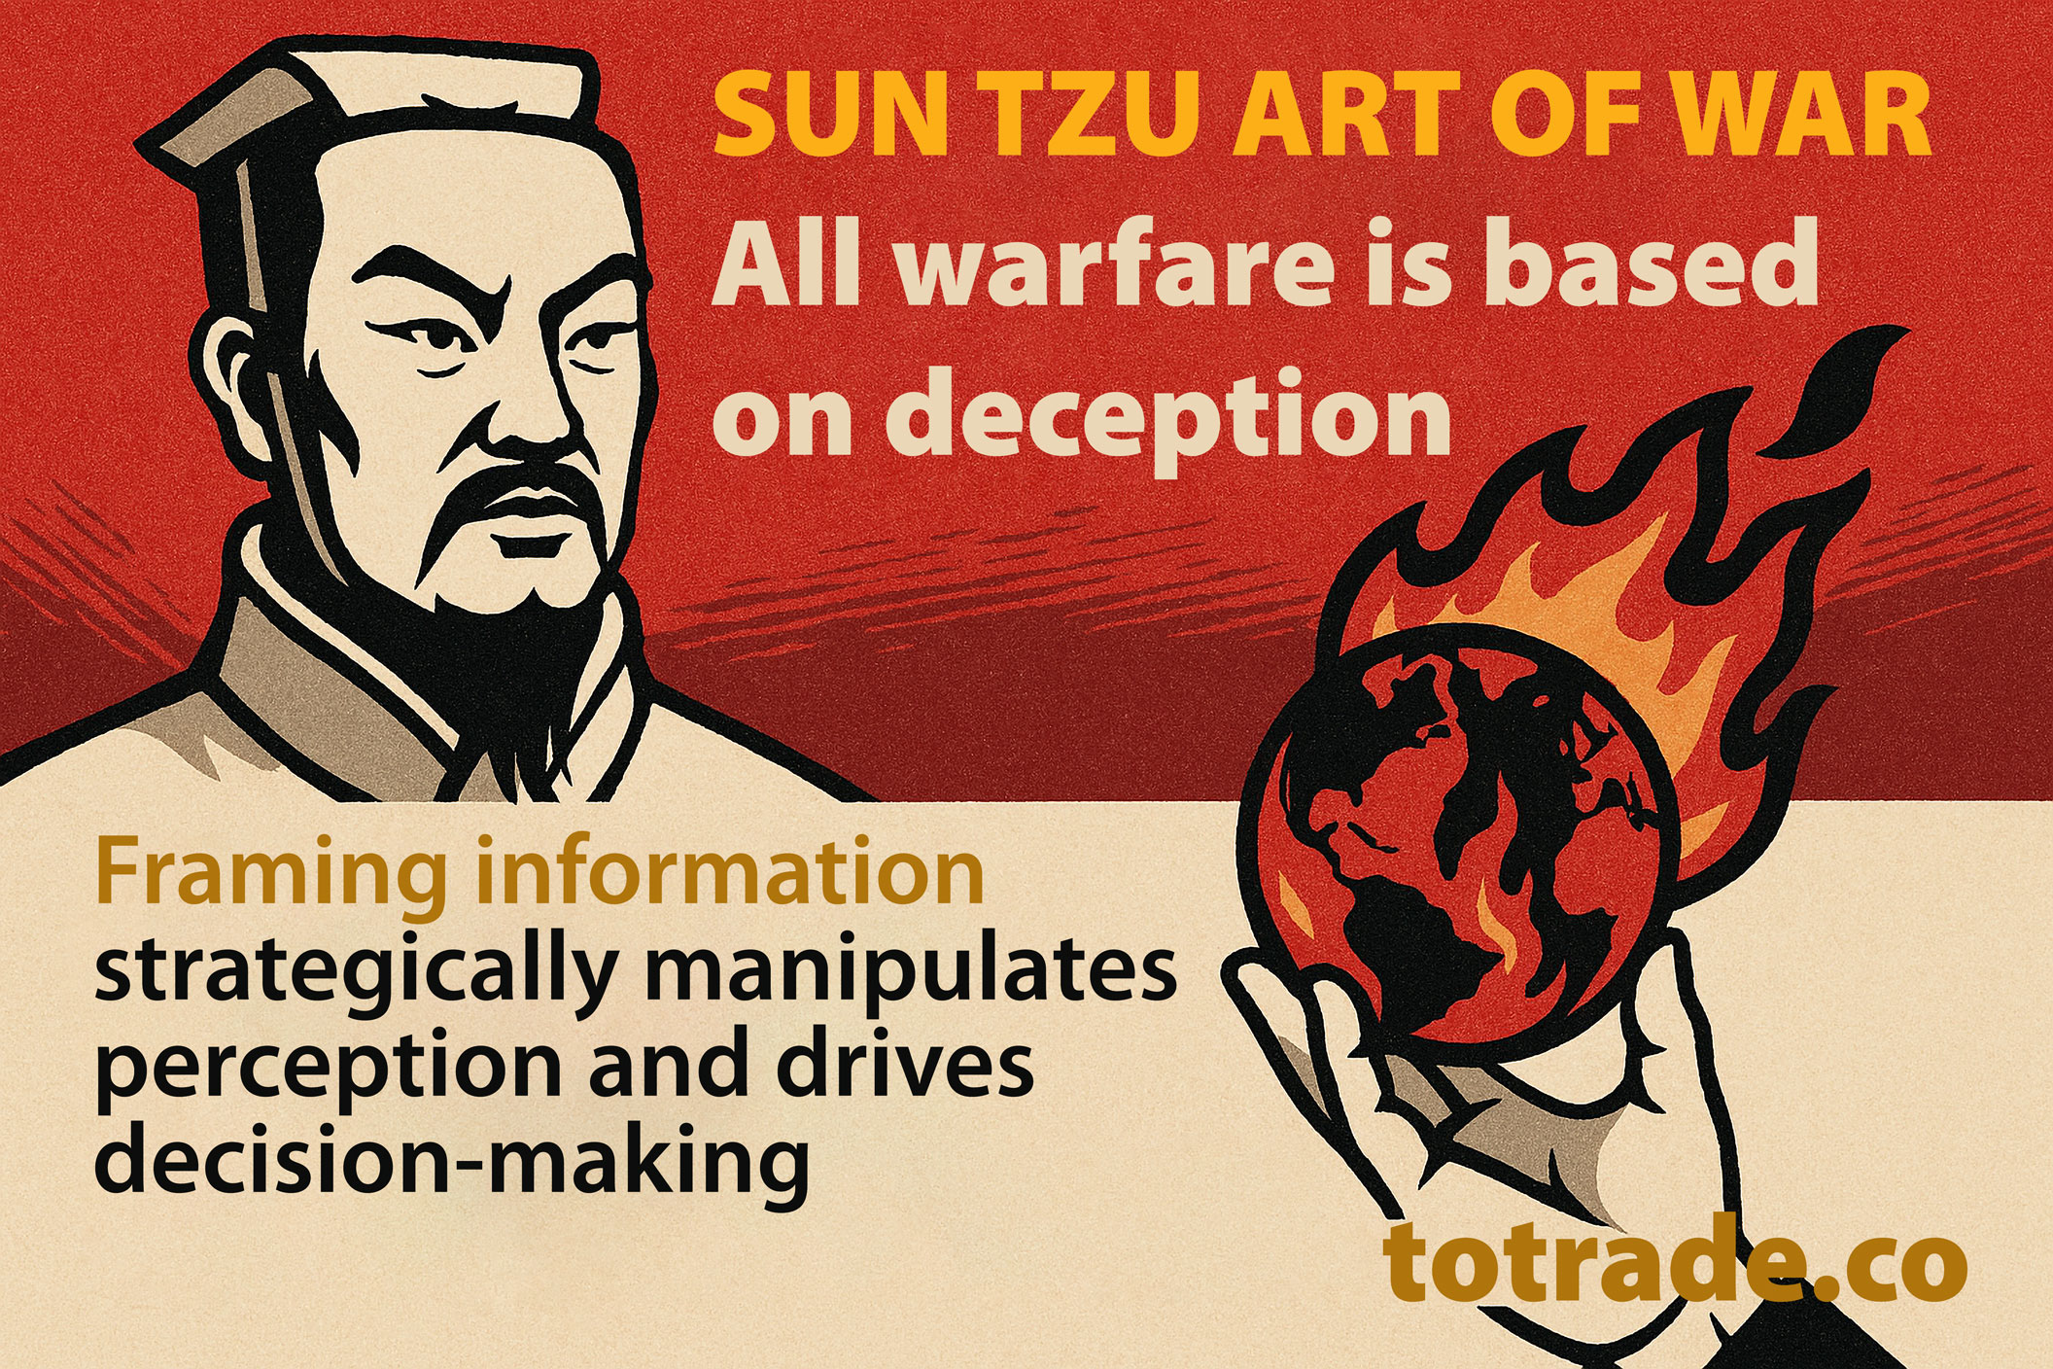

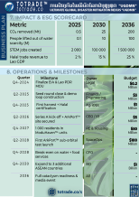
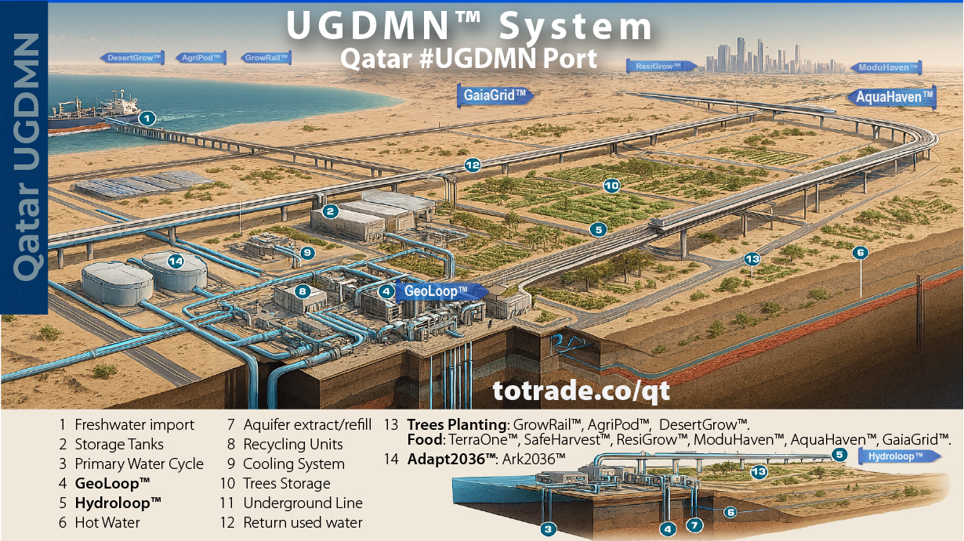
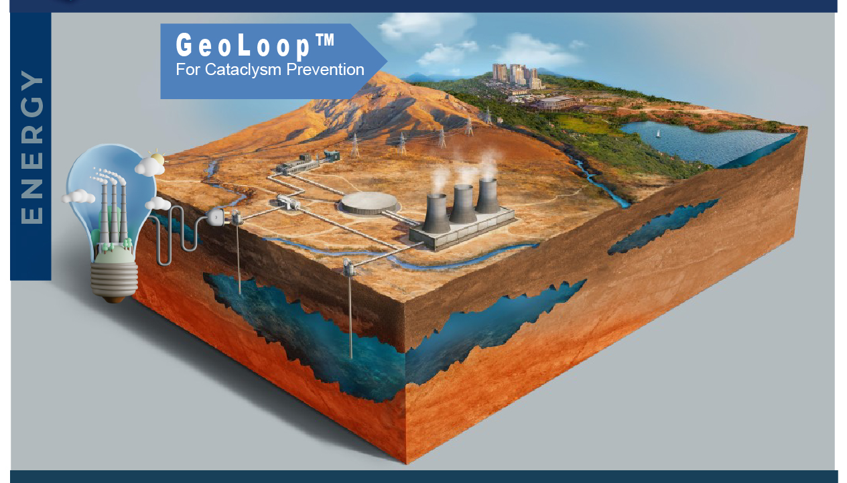


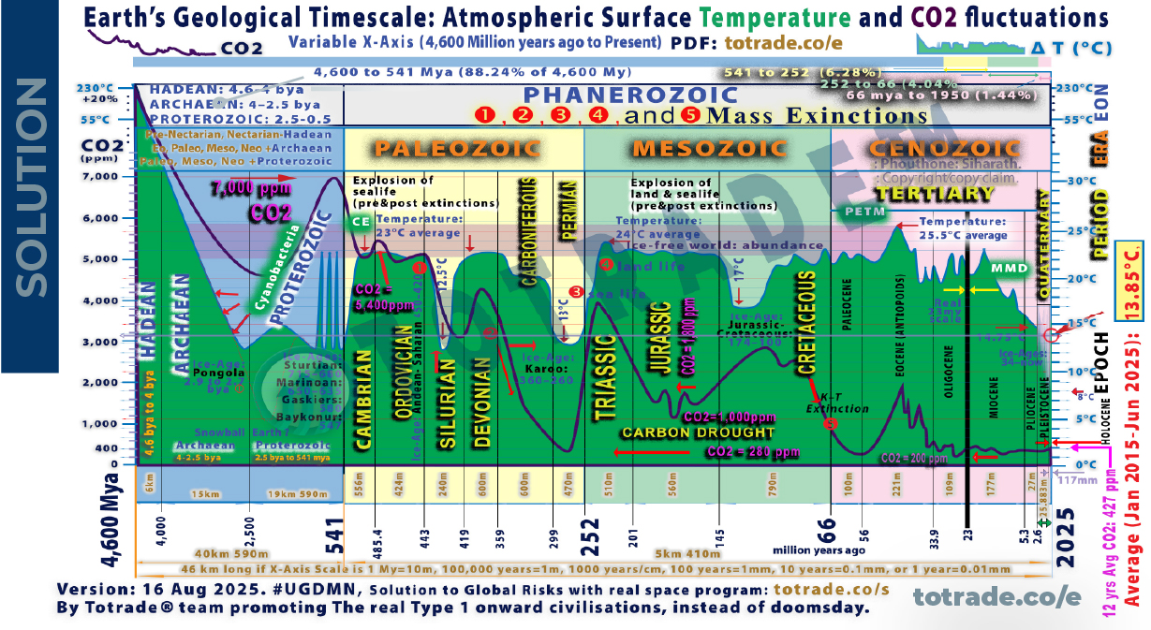

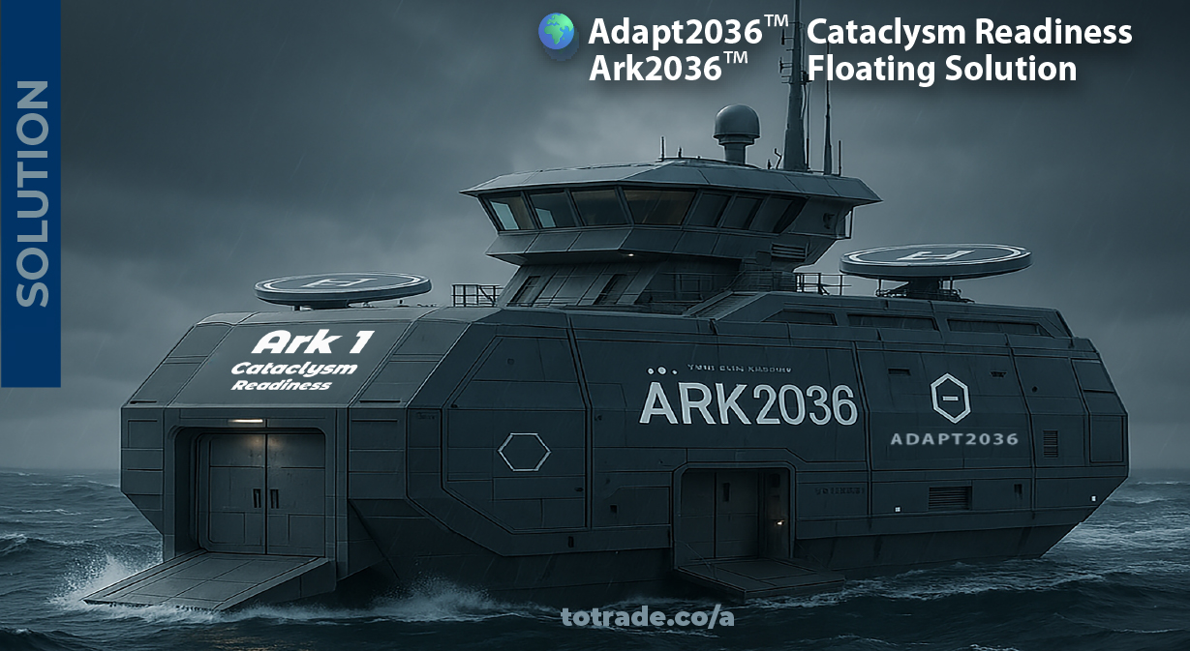






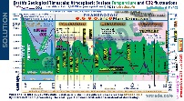







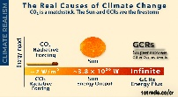

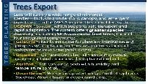

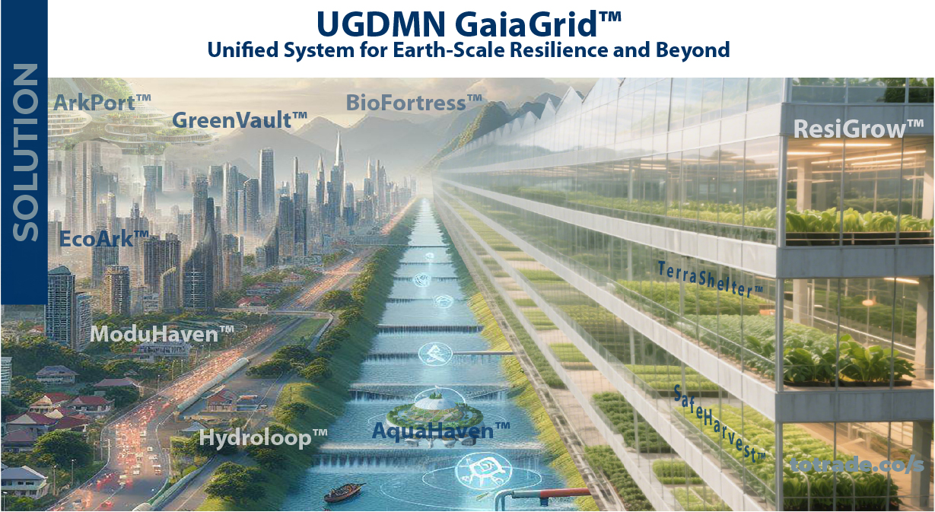


Notes:
Table of Contents:

Slide 3
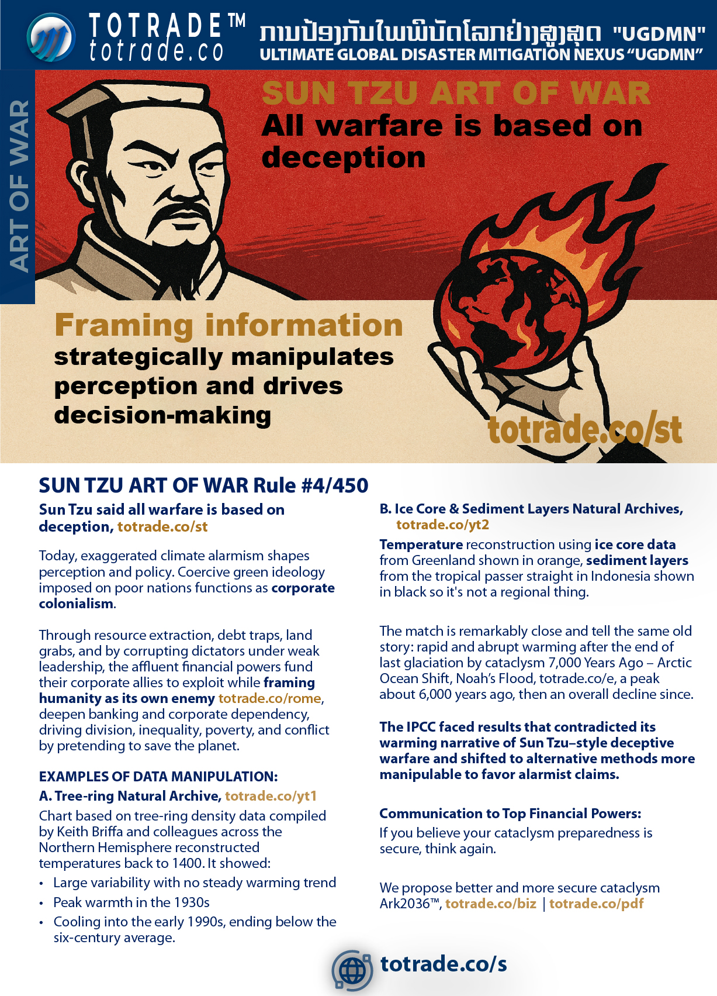


Notes:
SUN TZU ART OF WAR ( (Rule #4/450)
Sun Tzu said all warfare is based on deception.
Today, exaggerated climate alarmism shapes perception and policy. Coercive green ideology imposed on poor nations functions as corporate colonialism.
Through resource extraction, debt traps, land grabs, and by corrupting dictators under weak leadership, the affluent financial powers fund their corporate allies to exploit while framing humanity as its own enemy totrade.co/rome, deepen banking and corporate dependency, driving division, inequality, poverty, and conflict by pretending to save the planet.
EXAMPLES OF DATA MANIPULATION:
A. Tree-ring Natural Archive, youtu.be/K_8xd0LCeRQ?t=195
Chart based on tree-ring density data compiled by Keith Briffa and colleagues across the Northern Hemisphere reconstructed temperatures back to 1400. It showed:
• Large variability with no steady warming trend
• Peak warmth in the 1930s
• Cooling into the early 1990s, ending below the six-century average
B. Ice Core & Sediment Layers Natural Archives, youtube.com/jP8nz0cVbzQ&t=181s
Temperature reconstruction using ice core data from Greenland shown in orange, sediment layers from the tropical passer straight in Indonesia shown in black so it's not a regional thing.
The match is remarkably close and tell the same old story: rapid and abrupt warming after the end of last glaciation by cataclysm 7,000 Years Ago – Arctic Ocean Shift, Noah’s Flood, totrade.co/e, a peak about 6,000 years ago, then an overall decline since.
Let's wait how Climate Alarmism in the North Hemisphere will feel their Global Warming in winter.
The IPCC faced results that contradicted its warming narrative of Sun Tzu–style deceptive warfare and shifted to alternative methods more manipulable to favor alarmist claims.
Communication to Top Financial Powers:
If you believe your cataclysm preparedness is secure, think again.
Current strategies depend on fragile systems, misleading narratives, and hidden dependencies. True security demands funding solutions that protect people and resources, while enabling rapid post-cataclysm recovery and accelerating progress toward a Type I Civilization—without regressing to a Stone Age. Invest in #UGDMN to build resilience that is real, scalable, and rapid globally transformative.

Slide 4
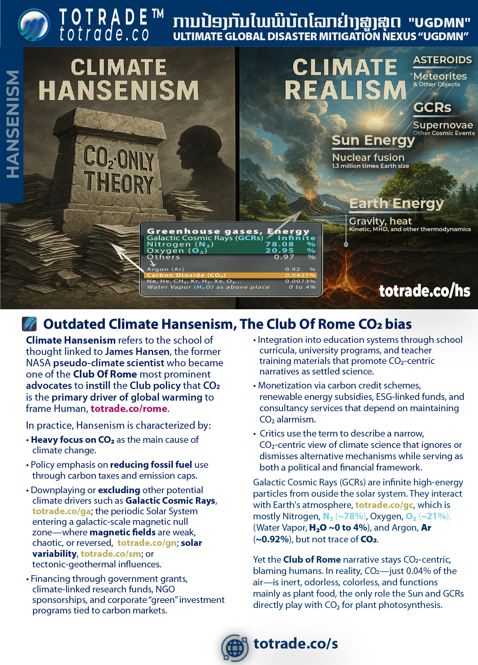


Notes:
Climate Hansenism
James Hansen, ex-NASA, promoted the Club of Rome’s CO2-centric agenda to frame human activity as the main driver of climate change. totrade.co/rome
Key traits:
• CO2 framed as primary cause of warming
• Fossil fuel cuts via taxes, caps, and carbon markets
• Other drivers sidelined: Galactic Cosmic Rays totrade.co/gc, Solar variability totrade.co/sm, Galactic null zones totrade.co/gn, tectonic-geothermal inputs
• Funded by state grants, NGOs, and “green” finance
• Pushed through school and university curricula
• Monetized via carbon credits, subsidies, ESG-linked funds
Reality check:
• Earth’s air: N₂ ~78%, O₂ ~21%, Ar ~0.92%, H₂O ~0–4%, CO₂ only 0.04%
• CO₂ is colorless, inert, plant food
• Climate shaped by Sun, GCRs, tectonics—not CO₂ at all

Slide 5


Slide 6


Notes:
This X-Axis variable graph is the combination of past climate studies by experts in their fields using natural archives through:
• Tree rings: Show temperature, rainfall, and drought cycles (dendroclimatologists)
• Sea sediment: Track ocean temperature, salinity, and biological activity (paleoceanographers).
• Ice cores: Record greenhouse gases, volcanic ash, and temperature shifts (glaciologists and palaeoclimatologists).
• Rock layers: Reveal long-term climate patterns and major events (stratigraphers and geologists).
• Lake sediment: Preserve pollen, charcoal, and minerals. Reflect vegetation and fire history (paleolimnologists).
• Speleothems: Cave formations record rainfall and temperature through isotopes (biologists and geochemists).
• Coral reefs: Growth bands and isotopes show sea surface temperature and salinity (marine biologists and geochemists).
• Historical documents: Include harvest records, ship logs, and diaries. Indicate past climate (historical climatologists).
• Glacier extent: Maps and photos show retreat or advance. Reflect temperature and precipitation (glaciologists and geomorphologists).
• Pollen analysis: From soil or sediment. Reveal past plant life and climate zones (palynologists).
• Charcoal layers: Indicate wildfires. Help track droughts and vegetation changes (paleo ecologists).
• Packrat middens: Preserve seeds and bones. Show local climate and ecosystem shifts (paleo ecologists and archaeologists).
Combining these studies, these archives confirm Earth is still in an Ice Age. For most of the last 550 million years, Earth was warmer, supporting vast forests and abundant life. Today’s cooler phase is part of a long-term cooling cycle.
Many geological, archaeological, and historical mysteries remain unresolved without acknowledging abrupt cataclysmic events as key drivers:
• Mammoths frozen with food in their mouths.
• Cities buried under miles of sediment.
• Fossil layers laid down in hours, not centuries.
• Ancient civilizations erased in a single day.
• Global myths of floods, fire, and sudden darkness.
• Polar shifts and crustal displacement every few thousand years.
These events explain sudden extinctions, lost continents, and resets in human progress. Ignoring them collapses timelines and creates contradictions in CO2-centric Hensenism evidence, totrade.co/hs
Accepting cataclysms as central to Earth’s history is essential to understand the past, prepare for the future, and solve mysteries that defy conventional models.
Ignoring natural cycles while pushing false climate narratives, like exaggerated heat records and cyclone claims, undermines credibility. The IPCC’s Climategate is a warning.
Imposing green ideology on poor nations through coercive climate policy is eco-colonialism. It forces decisions that harm people and economies to satisfy the environmental agenda of the affluent West.
Graph 2:
This graph combines evidence from multiple natural archives as previous slides but between 2.6 Mya to 11,700 ya
Earth’s climate change from 2.6 million years ago to the Holocene, integrating natural archives and cataclysmic events.
Natural archives show gradual shifts:
Tree rings, ice cores, lake and sea sediments, speleothems, coral reefs, pollen, charcoal, and rock layers confirm glacial–interglacial cycles. These cycles were driven by orbital changes (Milankovitch cycles), solar activity, and abrupt Galactic Cosmic Rays flux (GCRs). Temperature fluctuated ±5°C globally.
Cataclysmic events caused abrupt shifts:
The lithosphere rotated over the mantle in 6–12 hours. This repositioned poles to the Torrid Zone. Oceans and atmosphere continued rotating eastward at 1,037 mph. Supersonic winds and floods buried continents. Ice caps melted. New ones formed. Entire civilizations vanished. Fossil records show sudden extinctions. Mammoths froze instantly. Sedimentary layers show rapid deposition. Tiahuanaco was buried and later uplifted 12,500 feet.
Key transitions:
• 2.6 million years ago: Start of Pleistocene. Ice sheets expanded.
• 29,000 years ago: End of Wisconsin glaciation.
• 18,500 years ago: Hudson Bay polar shift.
• 11,500 years ago: Laurentian ice cap collapse. Global flood. Start of Holocene.
• 7,000 years ago: Noah’s flood. Arctic Ocean moved to North Pole.
• Today: Arctic era continues. Next shift expected ~2036.
Conclusion:
Natural archives show patterns. Cataclysms explain abrupt transitions. Climate change is not linear. It’s cyclical, sudden, and global. We must prepare.
📄 PDF: totrade.co/biz | totrade.co/pdf
📊 PowerPoint:
• Climate Realism: totrade.co/cr
• Business Plan: totrade.co/bp

Slide 7


Notes:
This graph 3 shows climate shifts from 11.7kya to 4.2kya, with abrupt and gradual phases confirmed by natural archives and cataclysmic evidence.
Younger Dryas Cooling
• Sudden return to glacial conditions around 12,900 years ago
• Caused by freshwater influx disrupting ocean currents
• Ended ~11,700 years ago with rapid warming
11,500 ya: Laurentian Ice Cap Collapse
• Triggered global flood
• Massive crustal shift repositioned poles
• Sudden climate reset marked start of Holocene
Holocene Climatic Optimum
(11,700–8,200 years ago)
• Warm, stable climate
• Forests expanded
• Agriculture began
8,200 years ago Cooling
• Abrupt drop in temperature
• Linked to meltwater pulse and ocean disruption
• Affected early civilizations
7,000 years ago: Noah’s Flood
• Arctic Ocean moved to North Pole
• Crust shifted again
• Global inundation and tectonic upheaval
• Less than 1% of life survived
Homeric Grand Solar Minimum
• Occurred during late Holocene
• Reduced solar activity
• Contributed to cooling trend
8,000 years ago to today: 3°C Cooling
• Gradual decline in global temperature
• Driven by orbital cycles and solar variation
• Stabilized ecosystems and enabled civilization growth
This period shows how cataclysms and cosmic forces shaped climate more than CO₂.
This graph 4 shows climate shifts between 4200 years ago and 1950, Earth’s climate shifted through solar cycles and abrupt cooling events. Natural archives and historical records confirm this.
• Homeric Grand Solar Minimum (~2800–2600 BCE)
Solar output dropped. Tree rings and ice cores show cooling. Crop failures and societal stress in Mesopotamia and Egypt. Linked to the 4.200year ago event that collapsed Akkadian and Old Kingdom Egypt.
• Roman Warm Period (~250 BCE–400 CE)
Global temperature rose ~+1°C above Holocene average. Confirmed by grape cultivation in Britain and Alpine glacier retreat. Enabled Roman expansion, trade, and population growth.
• Medieval Warm Period (~950–1250 CE)
Temperature rose +0.5 to +1.0°C. Tree rings and lake sediments confirm warming in Europe, Greenland, and parts of Asia. Norse settled Greenland. Vineyards expanded north. Monsoon patterns shifted.
• Oort Minimum (~1040–1080 CE)
Solar activity dropped. Cooling resumed. Tree rings show reduced growth. Glaciers advanced in Europe.
• Wolf Minimum (~1280–1350 CE)
Marked start of Little Ice Age. Cooling intensified. Crop yields fell. Famines spread across Europe and Asia.
• Spörer Minimum (~1460–1550 CE)
One of the coldest periods. Tree rings and ice cores show sharp cooling. Glaciers expanded. Harsh winters. Population decline in some regions.
• Maunder Minimum (~1645–1715 CE)
Deepest cold of Little Ice Age. Sunspot records show near-zero activity. Europe saw frozen rivers, failed harvests, and mass starvation. ΔT ~ -1.0°C.
• Dalton Minimum (~1790–1830 CE)
Solar activity dropped again. Cooling ~ -0.5°C. Tambora eruption (1815) amplified effects.
“Year Without a Summer” (1816). Global crop failures.
• Glassberg Minimum (~1870–1900 CE)
Final cooling phase before modern warming. Confirmed by glacier advance and tree ring contraction. Cold winters in Europe and North America.
• 1930s Warm Period
Global temperature rose ~+0.3°C. Dust Bowl in US. Arctic ice retreated. Confirmed by instrumental records and historical observations.
Conclusion:
Natural archives show patterns. Cataclysms explain abrupt transitions. Climate change is not linear. It’s cyclical, sudden, and global. We must prepare.
🔗 Science: totrade.co/g
📜 History: totrade.co/e | totrade.co/h
📄 PDF: totrade.co/biz | totrade.co/pdf
📊 PowerPoint:
• Climate Realism: totrade.co/cr
• Business Plan: totrade.co/bp

Slide 8


Notes:
This graph 5 shows climate shifts between 1950 and 1979, Earth’s climate shifted through solar cycles. Natural archives and historical records confirm this.
“Climate Change” between 1950 and 1979, now incorporating the surge in Galactic Cosmic Rays (GCRs) and lightning observations:
• Modern Solar Maximum Warming by 1°C while CO₂ unchanged.
Solar activity peaked. Sunspot counts rose. Earth warmed ~1°C. CO₂ remained near 315 ppm. Warming was solar-driven, not CO₂-induced.
• Warmer Climate, More Water Evaporation, releasing More CO₂,
CO₂ began rising slowly. Warmer air held more moisture. Evaporation increased. Cloud formation and precipitation patterns shifted. Oceans retained more heat.
• Post-50s Warming: Air and Ocean Feedback
Air warmed from solar maximum. Oceans released stored heat from Medieval Warm Period. Liquid thermal inertia amplified warming. Combined feedback raised global temperature.
• GCRs Start to Surge
NASA research confirmed GCRs influence lightning frequency. Chronis found increased lightning linked to cosmic ray flux. GCRs electrify the atmosphere, triggering more discharges. This marks a shift in Earth’s electrical environment.
• 1950–1998 Warming: +1°C
Late 1970s marked acceleration. Solar and ocean feedbacks caused ~1°C rise. No tipping point. No CO₂ spike. No cataclysm.
• Global Warming Scare
Based on short-term data. Graph shows only 0.75mm X-axis out of 46km total scale. Misleading scale exaggerates impact. Real climate change spans millions of years.
This graph 6 shows climate shifts between 1976 and 2025, Earth’s climate shifted through solar cycles. Natural archives and historical records confirm this.
Between 1979 and 2025, Earth’s climate shifted under declining solar activity and rising cosmic influences:
• Solar activity declined. See totrade.co/sm.
Japan universities linked this to increased lightning. See totrade.co/ln5.
• Galactic Cosmic Rays surged.
GCRs triggered cloud formation.
CERN CLOUD confirmed. See totrade.co/gc.
GCRs also increased lightning. Confirmed by NASA Earthdata (totrade.co/gcr1),
Frontiers in Physics (totrade.co/gcr2),
Climate Cosmos (totrade.co/ln1),
The Weather Network (totrade.co/gcr3),
and Yale Environment 360 (totrade.co/gcr4).
• Lightning spikes marked the surge.
Atmospheric ionization increased. Electrical storms intensified.
• IPCC manipulated data to hide the decline.
Climategate exposed suppression of cooling trends.
• The pause between 2002–2014
Global temperature stabilized. No warming. CO₂ continued rising.
• 2014–2018: Temperature declined by 0.90°C
Confirmed by satellite and ocean data. Cooling trend ignored in mainstream reports.
• 2018–2025: Continued cooling
UAH January 2025 report shows global temperature anomaly at +0.46°C, down from +0.62°C in December 2024.
• 2025: Unusual fruiting surge: GCR surge → more clouds → cooler upper atmosphere (La Niña) → more rain → more lightning → more nitrates → stronger plant growth and fruiting, totrade.co/fr, Proof: vt.tiktok.com/ZSBPFd8er
Trend since 1978: +0.15°C per decade. But recent years show decline due to La Niña and reduced solar activity.
Datagraver confirms monthly anomalies and 10-year moving average show cooling since 2016, totrade.co/dg.
Conclusion:
Natural archives show patterns. Cataclysms explain abrupt transitions. Climate change is not linear. It’s cyclical, sudden, and global. We must prepare.

Slide 9

Notes:
Accepting cataclysms as central to Earth’s history is essential to understand the past, prepare for the future, and solve mysteries that defy conventional models.
Ignoring natural cycles while pushing false climate narratives, like exaggerated heat records and cyclone claims, undermines credibility. The IPCC’s Climategate is a warning.
Threats (Art of War)
Imposing green ideology on poor nations through coercive climate policy is eco-colonialism. It forces decisions that harm people and economies to satisfy the environmental agenda of the affluent West.
By studying world history of cataclysms, we see that mega projects not built to withstand them signal failed leadership—and will drive citizens into collapse. totrade.co/ct
The Americans, more strategic, use the petrodollar—exchanging cheap paper for OPEC oil—to build sanctuaries and shield their citizens. totrade.co/ug1
Projected 2036 Cataclysm – Regional Risks
North America
• Cascadia rupture, 100m tsunamis
• Great Lakes merge, inland seas
• East Coast cities sunk (Hapgood)
Eurasia
• Mediterranean closes, Alps rise
• Himalayas uplift, Siberia melts
• SE Asia tilts: Laos uplifts, South China Sea drains, S. Thailand–Singapore–Indonesia sink
Middle East & Africa
• Middle East overheats, fractures, cities buried
• Africa splits, +100m tsunamis, then floods
Southern Hemisphere
• Australia coast lost, interior fertile
• Antarctica thaws, flash-freezes
Global
• Land stripped bare, rivers/lakes saline
• Gulf Stream collapse → instant ice age
• Weak magnetosphere → radiation surge

Slide 10

Notes:
Global Risk Assessment & Feasibility Studies
Beyond CO₂: Galactic Cosmic Rays and Cataclysms
• Recent extreme rainfall anomalies (bit.ly/ttfloods) signal deeper drivers beyond CO₂.
• CERN’s CLOUD experiment shows GCRs influence aerosol formation and cloud seeding, altering climate systems.
• Rising Galactic Cosmic Rays (GCRs), on multi-millennial cycles, are peaking toward ~2036, linked to solar activity decline.
• Mainstream focus on CO₂ masks the real risk: GCR-driven atmospheric and geophysical instability.
Why it matters:
• GCR surge destabilizes Earth’s interior → pressure buildup → supervolcanoes, megaquakes, crust slippage.
• Consequences: continent-scale floods, infrastructure collapse, cultural and technological loss, followed by global glaciation.
Cyclic cataclysms from Earth’s crustal displacement:
Mechanism
• A semi-molten layer 60–120 miles deep acts as lubricant.
• Off-axis ice caps build centrifugal stress.
• Magnetic and electrical disruption lets the crust slip.
• Poles shift into the Torrid Zone within hours, triggering upheaval.
Effects
• Supersonic winds over 1,500 km/h shred life and structures.
• Oceans race inland as walls of water miles high.
• Quakes split continents; molten rock floods lowlands.
• Flash-freezing locks life and mud in place.
Global Reach
• Americas drowned, burned, frozen.
• Europe and Asia devastated by sea, wind, quakes.
• Africa partly spared, split in half, and shaken.
• Antarctica and Greenland shift to equator; melting raises seas 150+ m.
• Survivors hide in mountains; civilization erased.
Parallels
• Myths of Noah, Vishnu, Osiris, Utnapishtim reflect earlier resets.
• Cuvier (1812) noted sudden global catastrophes.
• Later scholars tied legends, fossils, geology to recurring events.
Evidence
• Alaska, Siberia, North America bone beds show sudden freezing.
• Grand Canyon and Badlands strata record repeated floods.
• Ice cap growth drives instability.
Pattern
• Cycle repeats every few thousand years.
• Last five mapped over 35,000+ years.
• Next shift near 2036, tied to solar-cosmic change.
Outcome
• Oceans lay new mud layers.
• ASEAN and Australia emerge temperate refuges.
• Civilization resets to Stone Age.
This synthesis of geology, myth, and cataclysmology shows civilization ends in cycles of crustal displacement.

Slide 11

Notes:
🌌 Tourism vs Industry
Tourism keeps countries poor. No nation has ever achieved real wealth from tourism alone. Not even Thailand. Only rulers and their associates benefit. It’s a dangerous illusion.
Croatia example: To reach Switzerland-level wealth, it needs 1.9 billion tourist nights per year. It gets only 85 million. Thailand gets 35 million. Laos gets only 4 million. The math is clear.
Tourism has a hard ceiling. You cannot innovate serving drinks or cleaning rooms. It depletes forests, disturbs wildlife, pollutes waterways, damages roads, encourages prostitution, inflates land prices, displaces locals, and collapses under global crises like COVID. It creates a two-tiered society: a tiny wealthy elite owns land and properties, while most remain low-skilled, underpaid slave workers.
Laos’ true path is AI oriented scallable economy. Not to compete with China, but better: attract wealthy elites like Monaco or Dubai.
Monaco and Dubai attract wealthy elites and foreign direct investment (FDI), with shared strategies:
• No personal income tax, no capital gains tax, no wealth tax.
• Long-term residency tied to investment, property ownership, or elite status.
• High-end real estate markets with global appeal and strong returns.
• Exclusive lifestyle branding: safety, luxury, privacy, and elite events.
• Strategic location and global connectivity for trade and finance.
• Legal frameworks that support 100% foreign ownership in key sectors.
• Government-backed infrastructure and luxury development projects.
• Active promotion of elite-friendly policies and international investor confidence.
• Alignment with global standards and sustainability goals to attract ESG-focused capital.
FDI funds #UGDMN, details at totrade.co/biz, to build healthier living, cleaner air, safer Food-Energy-Water and Transport, cataclysm-ready infrastructure systems, and large-scale space program capabilities. In collaboration under elites inclusive enhanced multilateral partnership, deploy #UGDMN globally and beyond, totrade.co/qt ⇾ totrade.co/sp.

Slide 12


Slide 13


Slide 14


Slide 15


Slide 16


Slide 17




Slide 18


Slide 19


Slide 20


Slide 21


Slide 22


Slide 23


Slide 24


Slide 25


Slide 26


Slide 27


Slide 28


Slide 29


Slide 30


Slide 31


Slide 32


Slide 33


Slide 34


Slide 35


Slide 36


Slide 37


Slide 38


Slide 39


Slide 40


Slide 41


Slide 42


Slide 43


Slide 44


Notes:
Tower Bonanza to Stratosphere and Beyond
Visual Structure:
Base Level (Ground Floor)
• Circular base, 200km diameter, built from desert sand scaffolded by inclined cement-hemp walls
• GeoLoop™ geothermal system pushes hot water upward
• Staged reservoirs filled with cooled water from stratosphere for heavy transport
• Water-based cargo lifts and industrial platforms
• Mag-lev train spirals around the tower
Mid-Level (Stratosphere to LEO)
• Tower narrows into a cone, reaching ~160km height
• Diameter reduces to 10km at the top
• Hot water released at ~100km (Kármán line) for cooling and energy conversion
• Hydrogen-fuel factory and storage for space missions
LEO Platform (~160km)
• Launch pads, research stations, and orbital infrastructure
• Space elevator begins here, connecting to Higher Earth Orbit
HEO Platform
• Counterweight structure balances gravitational force
• Space station hub for interplanetary missions
• Energy conversion systems using gravity and kinetic forces
Surrounding Environment
• Desert transformed by cooled water into green zones
• Sea-level management infrastructure
• Zero-emission transport networks
Mission Statement:
#UGDMN™ accelerates humanity to Type I civilization. This structure replaces rockets with scalable, safe, and permanent access to space.

Slide 45


Slide 46


Slide 47


